Slide 1

Internet-based Database Systems
Changhoon Park
Department of Game Engineering
chpark@office.hoseo.ac.kr
August, 2006
Game Engines - 2006

Slide 2
Introduction
This lecture covers
  how to create
  a stable and fast database system
  for the game server
We will discuss
  the way to access the database
  from sockets and the Internet.

Slide 3
Why don’t store the data in local?
It is possible
  to store player information on the player’s local machine,
  in reality it makes much more sense
  to store the data on the server
  for many reasons

Slide 4
  1. The first and most important reason is
    to avoid players running “hacks” on their own computer to change their character data in the game or
    even backing the data up to another file.

Slide 5
  2. If the data is stored on the server,
    it makes it impossible
    for the player
    to run a local game hack
    that will modify the character data

Slide 6
  3. Another reasons for this is
    to allow players to play from different locations and machines
    without having to copy their character data to another computer

Slide 7
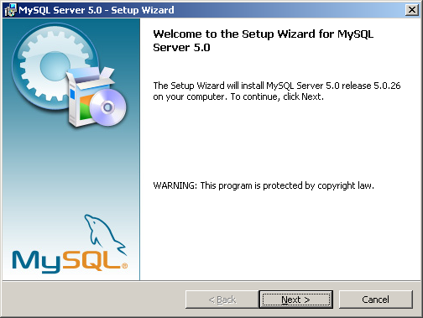
MySQL
Free download from http://www.mysql.com
  MySQL Community Server
    Windows Essentials (x86)

Slide 8
Most updated release version is 5.0
  Can be run in both UNIX and Windows platforms
  TCP/IP supported

Slide 9
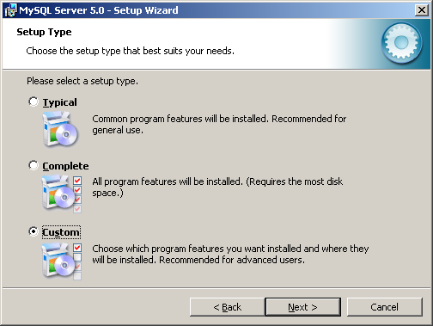

Slide 10
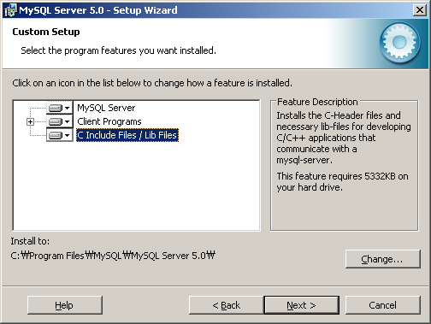

Slide 11
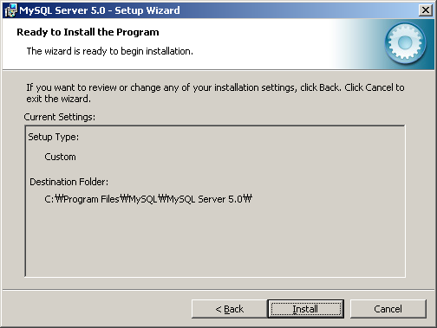

Slide 12
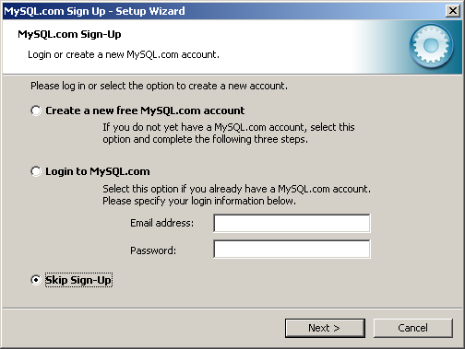

Slide 13
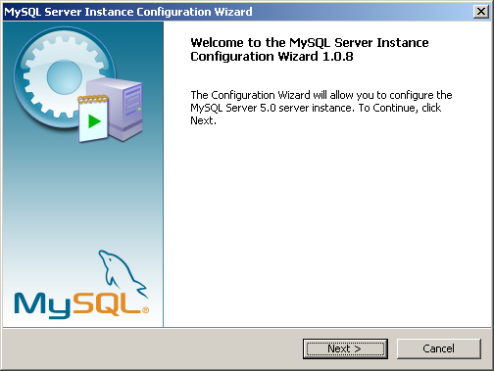
Configuration

Slide 14
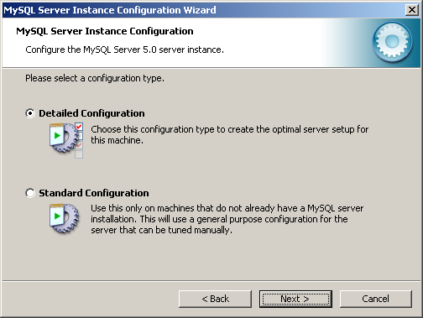

Slide 15
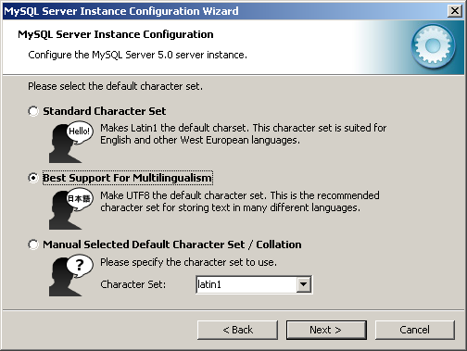

Slide 16
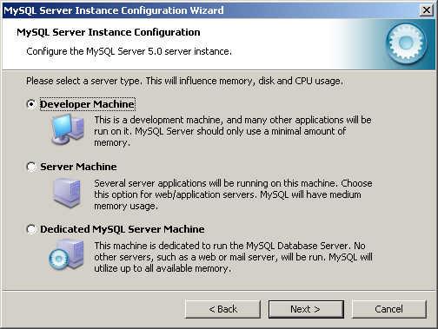

Slide 17
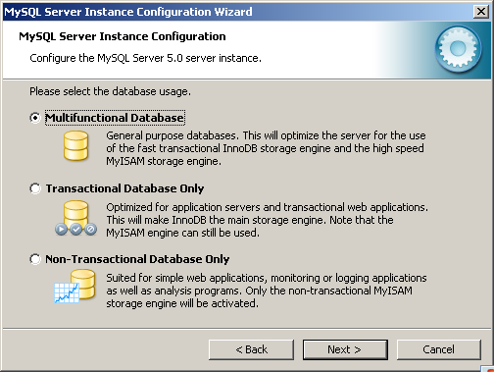

Slide 18
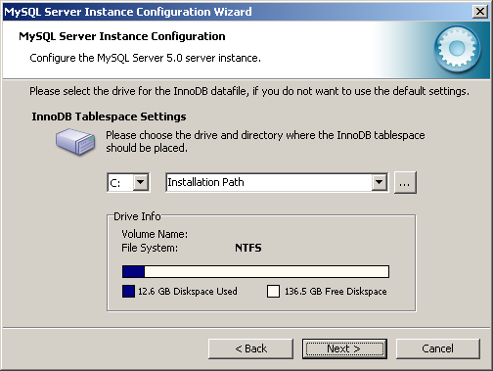

Slide 19
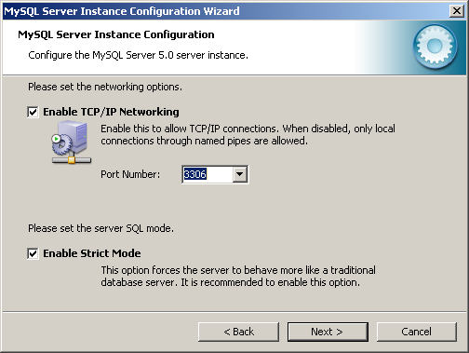

Slide 20
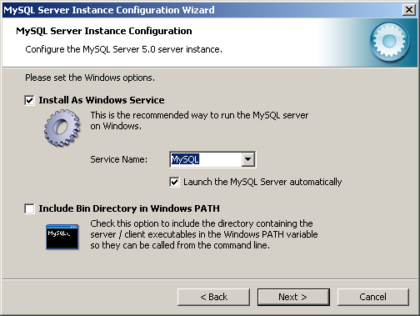

Slide 21
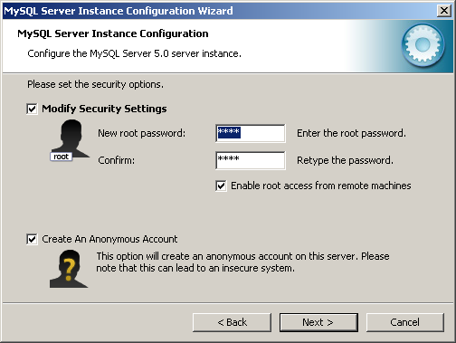

Slide 22
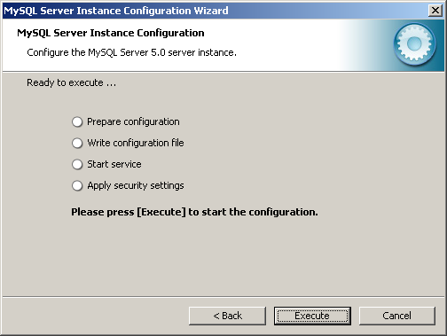

Slide 23
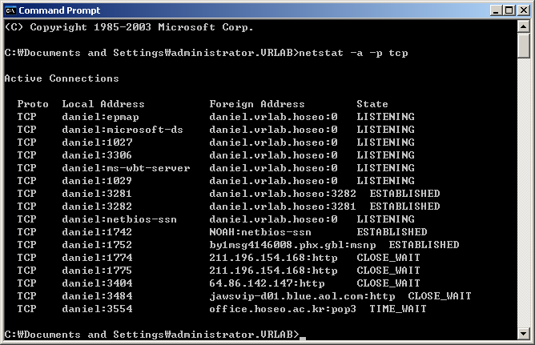
netstat –a –p tcp

Slide 24
Summary of MySQL
Administration commands
To start the MySQL Daemon
  mysqld or mysqld-nt
To stop the MySQL Daemon
  mysqladmin ( –p –u root ) shutdown

Slide 25
To start the MySQL command based interface
  mysql ( -p –u root )
To exit the MySQL command based interface
  quit

Slide 26
Creating a Database in MySQL
To create our gamedata database:
  mysql> CREATE DATABASE gamedata;

Slide 27
To view all the databases that have been created in our MySQL server:
  mysql> SHOW DATABASE;

Slide 28
To select which database we wish to work with:
  mysql> USE gamedata;

Slide 29
Adding Tables to a Database (1)
We would like to create a table
  to store several players character data
  in a database,

Slide 30
  each record should (at least) have the following information about the character for each player:
    Character Name
    X Position on the Map
    Y Position on the Map
    Current Experience Level

Slide 31
Adding Tables to a Database (2)
Following are the commands to create the table:
  mysql> USE gamedata;
  mysql> CREATE TABLE playerinfo (
  mysql> id INT AUTO_INCREMENT,
  mysql> name VARCHAR(30),
  mysql> xpos INT,
  mysql> ypos INT,
  mysql> exp INT,
  mysql> PRIMARY KEY(id));

Slide 32
Adding Data to Tables
We would like to add four records into the [playerinfo] table:
  mysql> INSERT INTO playerinfo VALUES
  mysql> (NULL, ‘Peter’, 14, 35, 1431),
  mysql> (NULL, ‘Paul’, 21, 86, 4563),
  mysql> (NULL, ‘Mary’, 10, 5, 231),
  mysql> (NULL, ‘John’, 13, 73, 5400);

Slide 33
Viewing Data in a Table
To select all the data from our table, we would use the following [SELECT] command;
  mysql> SELECT * FROM playerinfo;

Slide 34
  mysql> SELECT name, exp FROM playerinfo;
  mysql> SELECT * FROM playerinfo WHERE exp > 1000;
  mysql> SELECT id, name FROM playerinfo WHERE ypos = 86;
  mysql> SELECT * FROM playerinfo WHERE name LIKE “P%”;

Slide 35
Adding Extra Fields to Tables
We would like to modify the existing table structure:
  mysql> ALTER TABLE playerinfo ADD lastlogin TIMESTAMP;
  mysql> DESCRIBE playerinfo;
  mysql> ALTER TABLE playerinfo MODIFY name VARCHAR(50);

Slide 36
Updating Data in a Field
To update the field [lastlogin] for [John]’s record to [NULL]:
  mysql> UPDATE playerinfo SET lastlogin = NULL WHERE name = “John”;

Slide 37
To update the field [lastlogin] for [Paul]’s record to [13:45:35 05 Jan 2004]:
  mysql> UPDATE playerinfo SET lastlogin = “20040105134535” WHERE name = “Paul”;

Slide 38
Ordering Output
To view all the data in the table, but we wish to sort the [name]s in alphabetical order, we can use the following command:
  mysql > SELECT * from playerinfo ORDER BY name;

Slide 39
Other [SELECT] commands:
  mysql > SELECT * from playerinfo ORDER BY name DESC;

Slide 40
Retrieving the Last Data Entered
To select the maximum ID and
store it in a variable:
  mysql> SELECT @maxid:=MAX(id) FROM playerinfo;
  mysql> SELECT * FROM playerinfo WHERE id = @maxid;

Slide 41
  mysql> SELECT @lastlogin:=MAX(lastlogin) FROM playerinfo;
  mysql> SELECT * FROM playerinfo WHERE lastlogin = @lastlogin;

Slide 42
Limiting Output Data
To limit the output to a certain amount:
  mysql> SELECT * FROM playerinfo WHERE name LIKE “P%” LIMIT 2;

Slide 43
Deleting Tables and Databases
To delete a table:
  mysql> DROP TABLE playerinfo;
  mysql> SHOW TABLES;
To delete a database;
  mysql> DROP DATABASE gamedata;
  mysql> SHOW DATABASES;

Slide 44
Relational Databases (1)
Similar to other Management Information Systems, the database design for an online game server/multiplayer game server is similar:
  NOT possible to use a single table to store all the records
  Therefore, a set of tables are required
  As a result, normalization and table relationship should be formed

Slide 45
We need to create Five tables for the online game server:
  Player Data (id, name, X position, Y position, last login)
  Payment Info (id, player id, date payment made, payment type, amount paid)
  Notes (id, player id, note)
  Rel Friends (id, player id, friend id)
  Rel Enemies (id, player id, enemy id)

Slide 46
Creating the Relational Database (1)
To create the database:
  mysql> CREATE DATABASE onlinegame;
  mysql> SHOW DATABASES;
  mysql> USE onlinegame;

Slide 47
Player Data:
  mysql> CREATE TABLE playerdata (
  mysql> id INT auto_increment,
  mysql> name VARCHAR(50),
  mysql> xpos INT,
  mysql> ypos INT,
  mysql> lastlogin TIMESTAMP,
  mysql> PRIMARY KEY(id));

Slide 48
Payment Info
  mysql> CREATE TABLE paymentinfo (
  mysql> id INT auto_increment,
  mysql> playerid INT,
  mysql> datepaid TIMESTAMP,
  mysql> type VARCHAR(100),
  mysql> amt INT,
  mysql> PRIMARY KEY(id));

Slide 49
Notes
  mysql> CREATE TABLE notes (
  mysql> id INT auto_increment,
  mysql> playerid INT,
  mysql> note VARCHAR(255),
  mysql> PRIMARY(id));

Slide 50
Rel Friends
  mysql> CREATE TABLE relfriends (
  mysql> id INT auto_increment,
  mysql> playerid INT,
  mysql> friendid INT,
  mysql> PRIMARY KEY(id));

Slide 51
Rel Enemies
  mysql> CREATE TABLE relenemies (
  mysql> id INT auto_increment,
  mysql> playerid INT,
  mysql> enemyid INT,
  mysql> PRIMARY KEY(id));

Slide 52
Adding Relational Data
We simply use [insert] to add records into the above five tables:
  This part will be skipped and be done by yourself during the lab session.

Slide 53
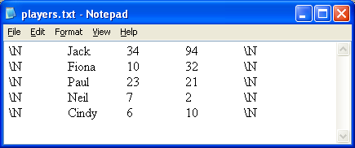
Other Methods of Data Input (1)
Text File Input
  mysql> LOAD DATA LOCAL INFILE “player.txt” INTO TABLE playerdata;

Slide 54
Backup and Restoration of Databases
To backup the database:
  c:\mysql\bin> mysqldump onlinegame > backup.sql
To restore the database:
  mysql> DROP DATABASE onlinegame
  mysql> CREATE DATABASE onlinegame
  c:\mysql\bin> mysql onlinegame < backup.sql

Slide 55
MySQL C++ Interface
The C++ interface for MySQL is
  MySQL++
Free download from http://www.mysql.com/downloads/api-mysql++.html

Slide 56
#include <mysql++.h>
#include <iomanip>
#include <iostream>
using namespace std;
using namespace mysqlpp;
static ostream&
separator(ostream& os)
{
os << endl << "---------------------------" << endl << endl;
return os;
}

Slide 57
int main(int argc, char* argv[])
{
// -> Create a connection to the database
Connection con("gamedata","127.0.0.1","root","");
// -> Create a query object that is bound to our connection
Query query = con.query();
// -> Assign the query to that object
//query << "SELECT * FROM paymentinfo";
//mysqlpp::Connection con(mysqlpp::use_exceptions);
//try {
//con.connect("gamedata","127.0.0.1","root","");
//mysqlpp::Query query = con.query();

Slide 58
query << "show databases";
cout << "Query: " << query.preview() << endl;
mysqlpp::Result res = query.store();
cout << "Databases found: " << res.size();
mysqlpp::Row row;
cout.setf(ios::left);
mysqlpp::Result::iterator i;
for (i = res.begin(); i != res.end(); ++i) {
row = *i;
int a = 0;
cout << endl << '\t' << setw(17) << row.raw_data(0);
}
cout << separator;

Slide 59
con.select_db("gamedata");
query.reset();
query << "show tables";
cout << "Query: " << query.preview() << endl;
res = query.store();
cout << "Tables found: " << res.size();
cout.setf(ios::left);
for (i = res.begin(); i != res.end(); ++i) {
row = *i;
string xx(row.at(0));
cout << endl << '\t' << setw(17) << xx; // row.raw_data(0);
}
cout << separator;

Slide 60
query.reset();
query << "select * from playerinfo";
// cout << "Query: " << query.preview() << endl << endl;
res = query.store();
int columns = res.num_fields();
cout << "fields = " << res.num_fields() << ", rows = " <<
res.size() << endl;
volatile MYSQL_RES* ress = res.raw_result();
if (!ress)
return -1;
for (i = res.begin(); i != res.end(); ++i) {
row = *i;
for (int counter = 0; counter < columns; counter++) {
cout << string( row.at(counter)) << " ";
}
cout << endl;
}
return 1;
}

Slide 61
#include <iostream>
#include <iomanip>
#include <mysql++>
int main(void)
{
// -> Create a connection to the database
Connection con("gamedata","127.0.0.1");
// -> Create a query object that is bound to our connection
Query query = con.query();
// -> Assign the query to that object
query << "SELECT * FROM paymentinfo";
// -> Store the results from then query
Result res = query.store();
// -> Display the results to the console
// -> Show the Field Headings
cout.setf(ios::left);
cout << setw(6) << "id"
<< setw(10) << "playerid"
<< setw(20) << "datepaid"
<< setw(20) << "type"
<< setw(20) << "amount" << endl;
Result::iterator i;
Row row;
// The Result class has a read-only Random Access Iterator
for (i = res.begin(); i != res.end(); i++)
{
row = *i;
cout << setw(6) << row["id"]
<< setw(10) << row["playerid"]
<< setw(20) << row["datepaid"]
<< setw(20) << row["type"]
<< setw(20) << row["amount"] << endl;
}
return 1;
}
Example 1 – Connecting and Retrieving Data from MySQL

Slide 62
#include <iostream>
#include <iomanip>
#include <mysql++>
int main(void)
{
// -> Create a connection to the database
Connection con("gamedata","127.0.0.1");
// -> Create a query object that is bound to our connection
Query query = con.query();
//// DISPLAY BEFORE UPDATE
// -> Assign the query to that object
query << "SELECT * FROM paymentinfo WHERE id = 4";
// -> Store the results from then query
Result res = query.store();
// -> Display the results to the console
cout << "Before Update" << endl;
cout << "-------------" << endl;
// -> Show the Field Headings
cout.setf(ios::left);
cout << setw(6) << "id"
<< setw(10) << "playerid"
<< setw(20) << "datepaid"
<< setw(20) << "type"
<< setw(20) << "amount" << endl;
Result::iterator i;
Row row;
// The Result class has a read-only Random Access Iterator
for (i = res.begin(); i != res.end(); i++)
{
row = *i;
cout << setw(6) << row["id"]
<< setw(10) << row["playerid"]
<< setw(20) << row["datepaid"]
:
Example 2 – Updating Data in MySQL from an Application (1)

Slide 63
:
<< setw(20) << row["type"]
<< setw(20) << row["amount"] << endl;
}
//// UPDATE THE INFORMATION
// Send an execute an update query in mySQL
query << "UPDATE paymentinfo SET type = \'American Express\' WHERE id = 4";
query.execute();
//// DISPLAY AFTER UPDATE
// -> Assign the query to that object
query << "SELECT * FROM paymentinfo WHERE id = 4";
// -> Store the results from then query
res = query.store();
// -> Display the results to the console
cout << endl << endl;
cout << "After Update" << endl;
cout << "------------" << endl;
// -> Show the Field Headings
cout.setf(ios::left);
cout << setw(6) << "id"
<< setw(10) << "playerid"
<< setw(20) << "datepaid"
<< setw(20) << "type"
<< setw(20) << "amount" << endl;
// The Result class has a read-only Random Access Iterator
for (i = res.begin(); i != res.end(); i++)
{
row = *i;
cout << setw(6) << row["id"]
<< setw(10) << row["playerid"]
<< setw(20) << row["datepaid"]
<< setw(20) << row["type"]
<< setw(20) << row["amount"] << endl;
}
return 1;
}
Example 2 – Updating Data in MySQL from an Application (2)

